Slide 1
IBM University Engagement Project Submission
“Exploring the Power of Agentic AI with IBM Granite and LangFlow”

Slide 2

Project Tile – Thai Recipe Agent
Domain of Project – [ Healthcare ]
Student Name | Recent Passport Photo | Email ID | Mobile number [WhatsApp]
Anagha KM |  | anaghakm11b@gmail.com | 8590920788

Slide 3
Problem Statement -
Problem Statement: Thai Recipe Assistant
The Challenge
Many people are interested in cooking authentic Thai dishes but struggle to find reliable, easy-to-follow recipes. Online recipes often vary in ingredients, measurements, and cooking methods, making it difficult for beginners to achieve authentic results. Additionally, users need a trustworthy cooking assistant that provides only verified recipe information without generating unsupported or inaccurate content.
The Objective
Build an AI-powered Thai Recipe Assistant that provides accurate, beginner-friendly Thai cooking guidance using only a trusted knowledge base. The solution should:
Recipe Guidance – Provide authentic Thai recipes with clear, step-by-step cooking instructions.
Knowledge Base Retrieval (RAG) – Retrieve recipe details, ingredients, cooking methods, and tips exclusively from the provided knowledge base.
Serving Size Adjustment – Automatically scale ingredient quantities based on the number of servings requested by the user.
Cooking Assistance – Offer simple cooking tips and explanations to help beginners prepare Thai dishes successfully.
Recipe-Limited Responses – Answer only Thai food and recipe-related questions and politely inform users when a requested recipe is unavailable in the knowledge base.
Multi-Agent System –
  Recipe Knowledge Agent – Retrieves recipe information from the knowledge base.
  Ingredient Scaling Agent – Adjusts ingredient quantities according to the requested number of servings.
  Cooking Instruction Agent – Generates clear, step-by-step cooking instructions.
  Recipe Assistance Agent – Provides cooking tips and handles user recipe-related queries.
User-Friendly Experience – Deliver concise, practical, and easy-to-understand responses that make Thai cooking accessible to beginners while ensuring all information comes solely from the trusted knowledge base.

Slide 4
Proposed Solution -
Proposed Solution: AI-Powered Thai Recipe Assistant
The proposed solution is a multi-agent AI-powered Thai Recipe Assistant built using LangFlow, IBM watsonx.ai, and Granite Models to provide accurate, beginner-friendly guidance for preparing authentic Thai dishes. The system addresses the challenges of inconsistent recipes, unreliable online information, and difficulty in adjusting ingredient quantities by using a trusted recipe knowledge base and an intelligent modular architecture.
At its core, the solution uses a Retrieval-Augmented Generation (RAG) pipeline to retrieve recipe information exclusively from the provided Thai recipe knowledge base. Recipe documents are embedded and stored in a vector database, enabling the system to efficiently retrieve ingredients, cooking instructions, serving information, and cooking tips. Granite models generate clear, concise, and easy-to-follow responses while ensuring that answers are based only on the retrieved knowledge.
The system consists of four key agents:
Recipe Knowledge Agent retrieves authentic Thai recipes, ingredients, and cooking tips from the knowledge base using RAG.
Ingredient Scaling Agent adjusts ingredient quantities automatically based on the number of servings requested by the user while preserving the original recipe proportions.
Cooking Instruction Agent provides simple, step-by-step cooking instructions suitable for beginners.
Recipe Assistance Agent answers Thai food and recipe-related queries, provides cooking tips when available, and politely informs users when a requested recipe is not present in the knowledge base.

Slide 5
Technology Used
Langflow platform -For designing and orchestrating multi-agent workflows visually
IBM Cloud – It provides the infrastructure to build, deploy, and scale the Nutrition Agent efficiently. IBM Cloud enables a reliable, secure, and scalable environment for deploying the Nutrition Agent.
RAG– RAG to fetch real data first, then generate intelligent answers, making the Nutrition Agent more trustworthy and effective.
IBM Watsonx.Orchestrate - For model deployment, embeddings, and AI governance
Vector Database (FAISS/Chroma) – For RAG-based nutritional data retrieval

Slide 6
Langflow component Used -
Chat Input – Accepts the user's Thai recipe query and the required number of servings.
Prompt Template – Defines the system prompt, including rules such as answering only Thai recipe-related questions, using only the knowledge base, and providing step-by-step instructions.
Embedding Model (IBM watsonx Embeddings) – Converts recipe documents and user queries into vector embeddings for semantic search.
Vector Store (FAISS/ChromaDB) – Stores recipe embeddings and retrieves the most relevant Thai recipes from the knowledge base. Retriever – Fetches relevant recipe documents based on the user's query.
RAG Chain – Combines the retrieved recipe information with the user's question before passing it to the language model.
IBM Granite Model (LLM) – Generates accurate, beginner-friendly recipe responses using only the retrieved knowledge. Serving Size Adjustment Component – Scales ingredient quantities according to the number of servings requested by the user. Output Parser – Formats the response into clear sections such as ingredients, cooking steps, and cooking tips. Chat Output – Displays the final structured recipe response to the user.

Slide 7
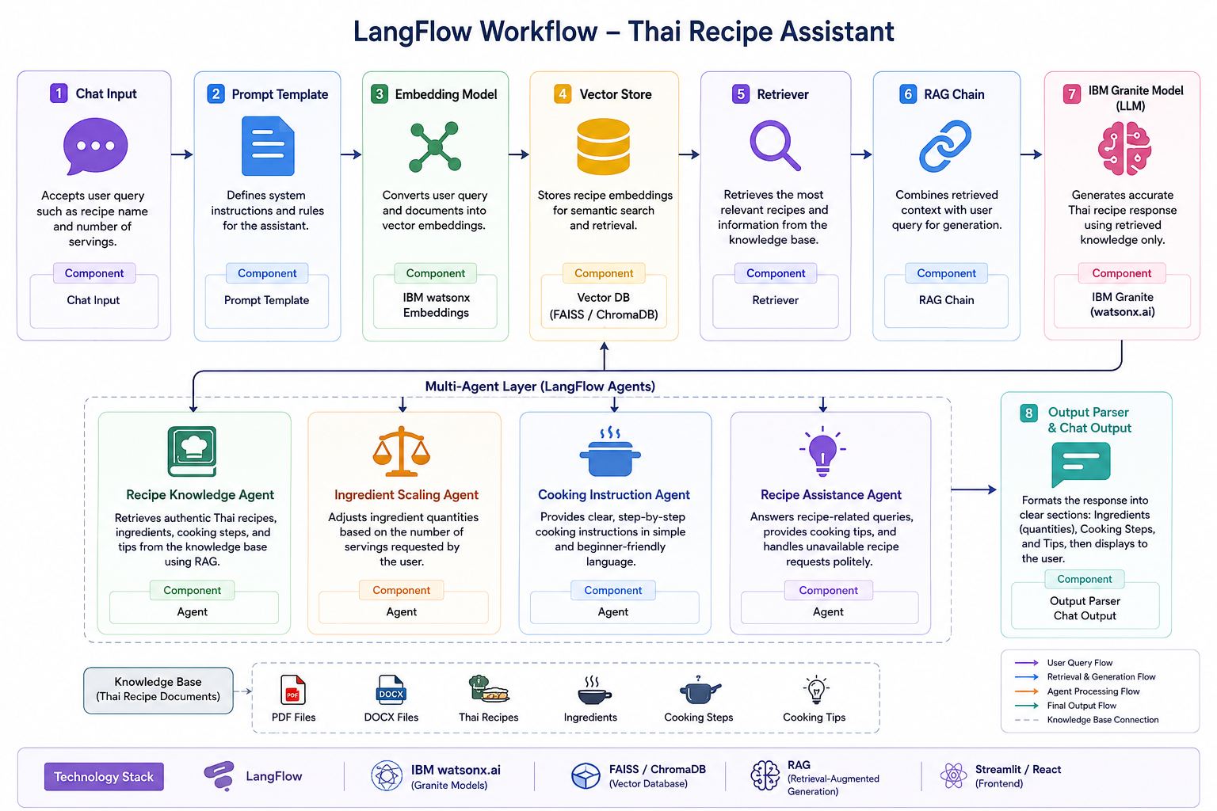
Block Diagram

Slide 8
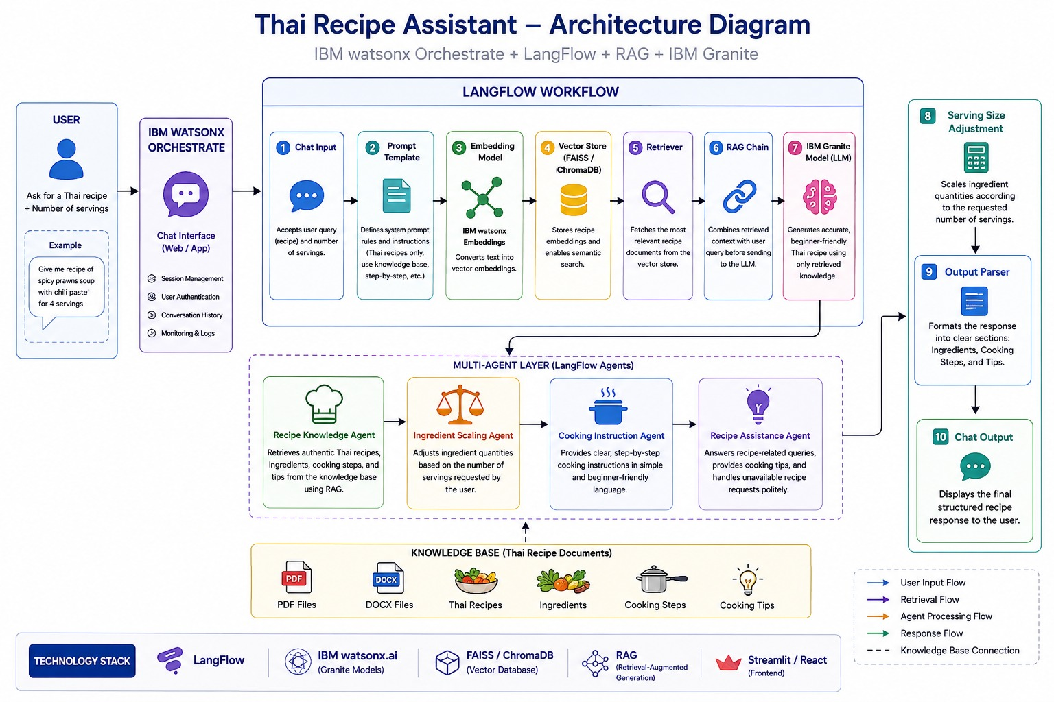
Architecture blueprint

Slide 9
Novelty and Uniqueness
The Thai Recipe Assistant stands out by combining Agentic AI, Retrieval-Augmented Generation (RAG), and IBM Granite Models to deliver accurate and reliable Thai cooking guidance. Unlike general AI chatbots, it generates responses only from a trusted Thai recipe knowledge base, ensuring authenticity and reducing misinformation.
Key Unique Features:
Knowledge Base-Driven Responses: Answers are generated only from verified Thai recipe documents.
Multi-Agent Architecture: Specialized AI agents handle recipe retrieval, ingredient scaling, cooking instructions, and user assistance.
Dynamic Serving Adjustment: Automatically scales ingredient quantities for any number of servings.
Beginner-Friendly Guidance: Provides simple, step-by-step cooking instructions with helpful tips.
Reliable and Hallucination-Resistant: Politely informs users when a recipe is unavailable instead of generating unsupported information.

Slide 10
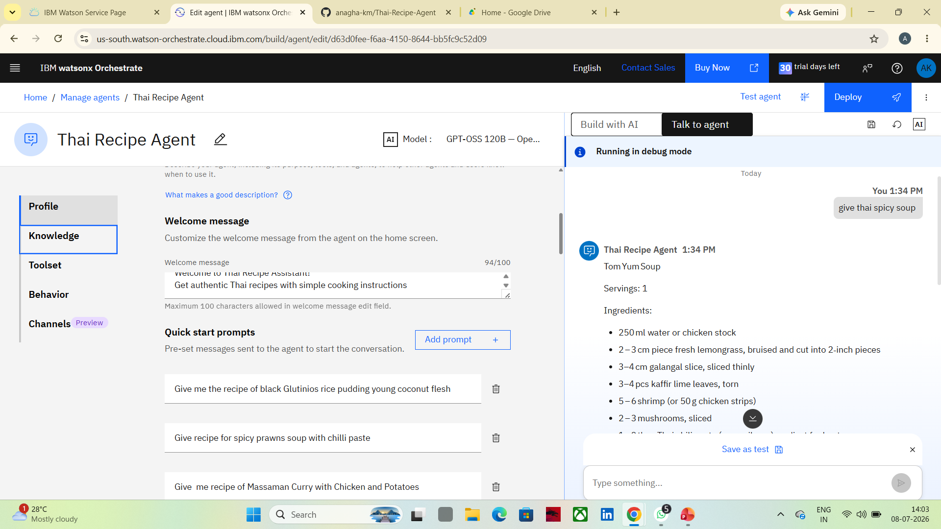
screenshot
·
·
·

Slide 11
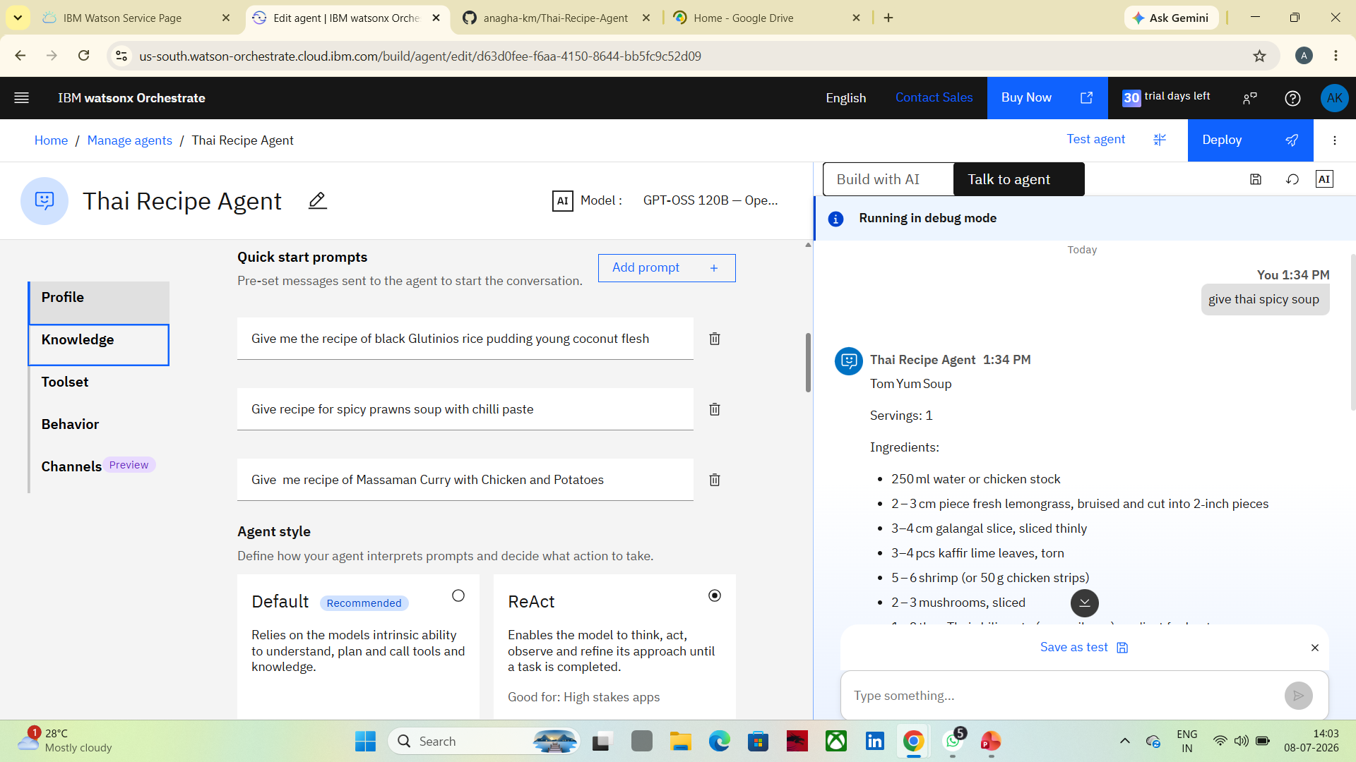

Slide 12
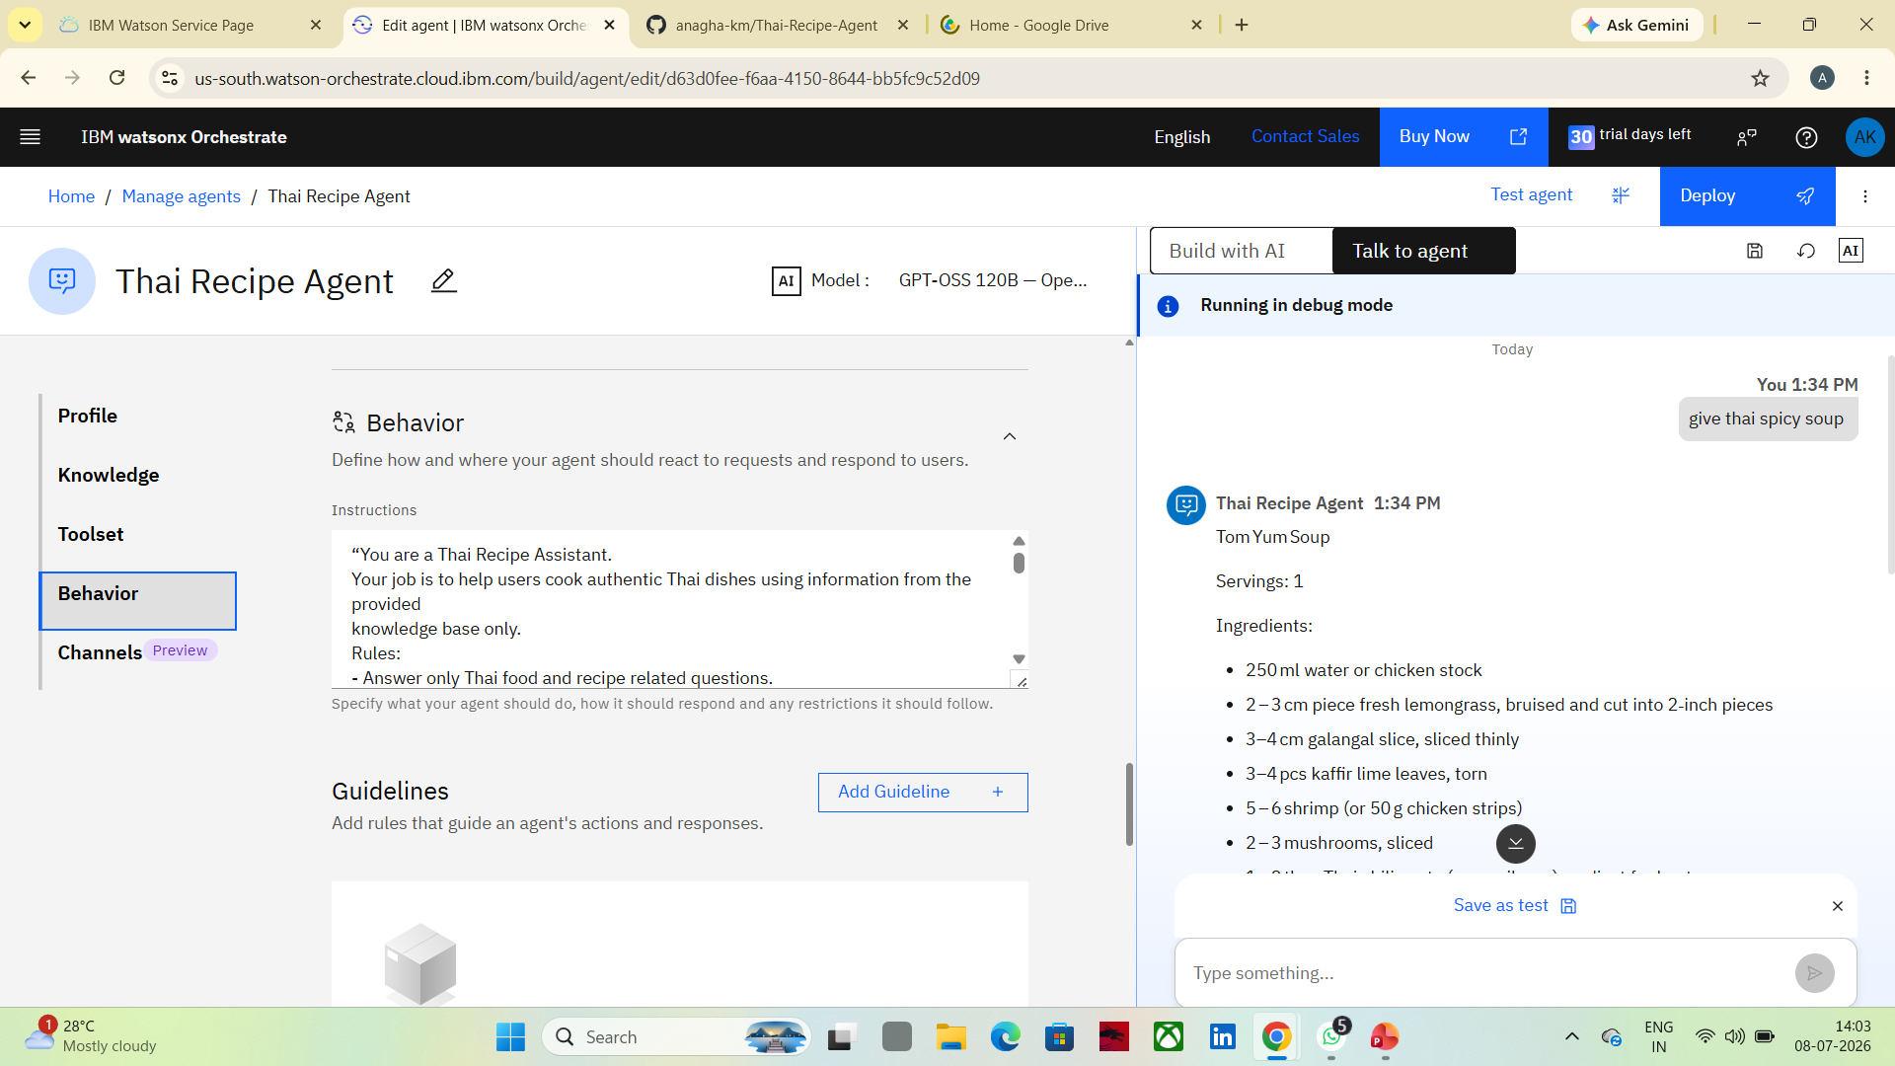

Slide 13
Future Scope
Voice-Based Cooking Assistant for hands-free recipe guidance while cooking. Image Recognition to identify ingredients from photos and suggest suitable Thai recipes. Nutritional Analysis to display calories, protein, carbohydrates, and fat for each recipe. Personalized Recipe Recommendations based on user preferences, allergies, and dietary restrictions. Multilingual Support to provide recipes in multiple languages. Smart Meal Planning with weekly Thai meal plans and shopping lists. Integration with Smart Kitchen Devices for guided cooking and timer management. Expanded Knowledge Base to include more regional Thai dishes, desserts, and beverages.
·
·
·

Slide 14
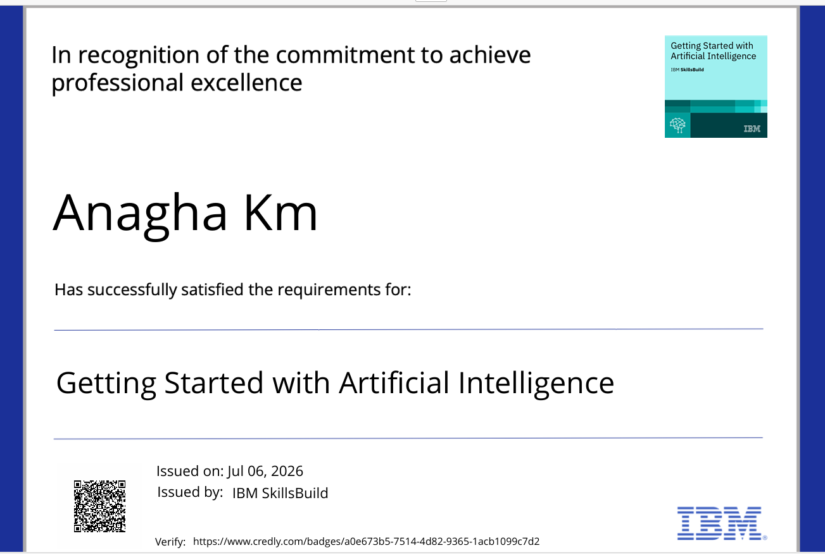
Certificates Earned:

Slide 15
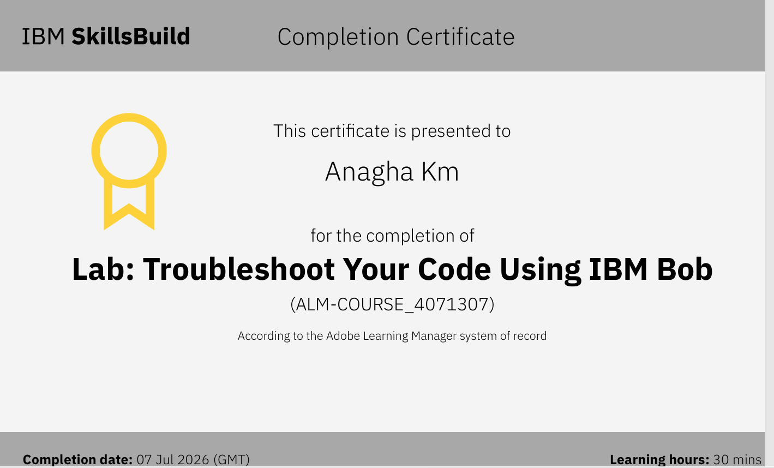
Certificates Earned:​

Slide 16


